Slide 1

Early Level Curriculum Evening
Wednesday 16th September, 2026
Amy Finlay
Tina Dingwall

Slide 2
Agenda
What a day in P1 looks like.
Play
Literacy
Numeracy
Time to explore resources and ask questions

Slide 3


Slide 4
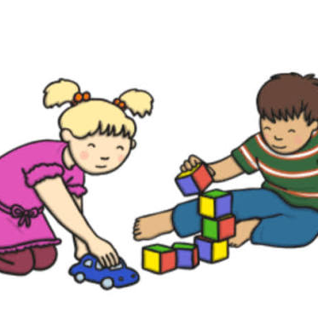
Why Play?
Children are naturally curious and creative- they should be leading their learning!
It is developmentally appropriate- Dundee Standard
It lifts the ceiling in terms of achievement- when play is open ended the opportunities for learning are limitless alongside skilled practitioners
It supports development of social skills- role play and shared games support children’s emotional and social development
It supports language and communication- allows children to interact with adults and peers- expanding vocabulary and encouraging conversational skills
It supports independence and resilience- through problem- solving children learn from mistakes and have opportunities to try things in different ways
Physical development- promotes gross and fine motor skills

Slide 5
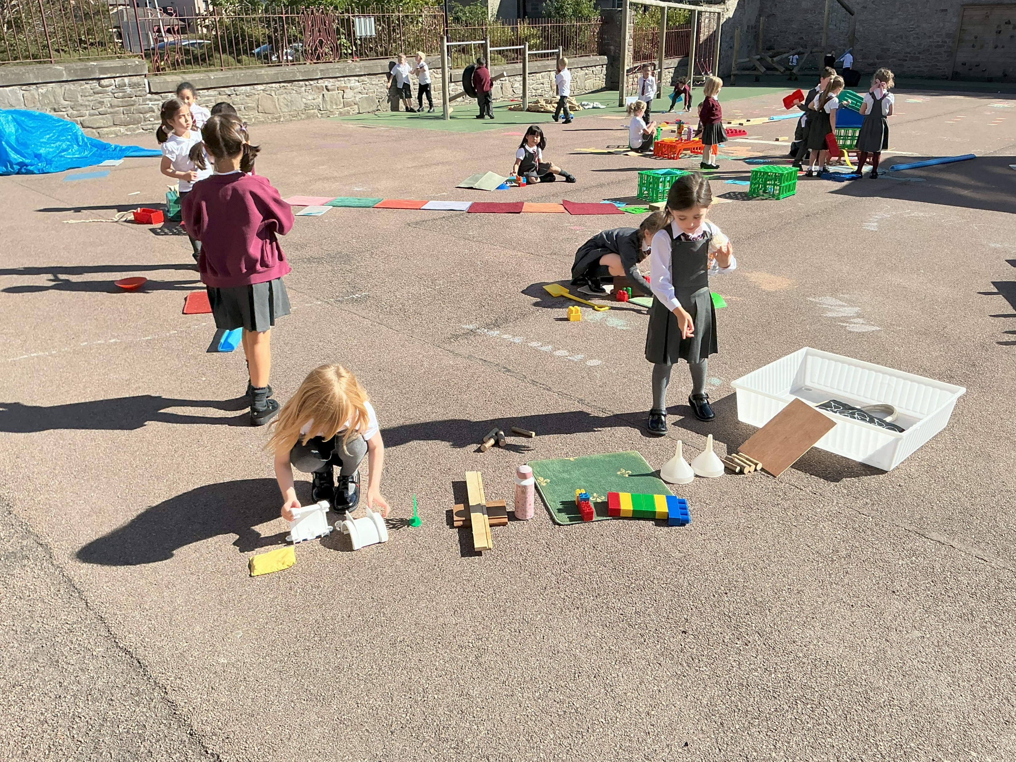
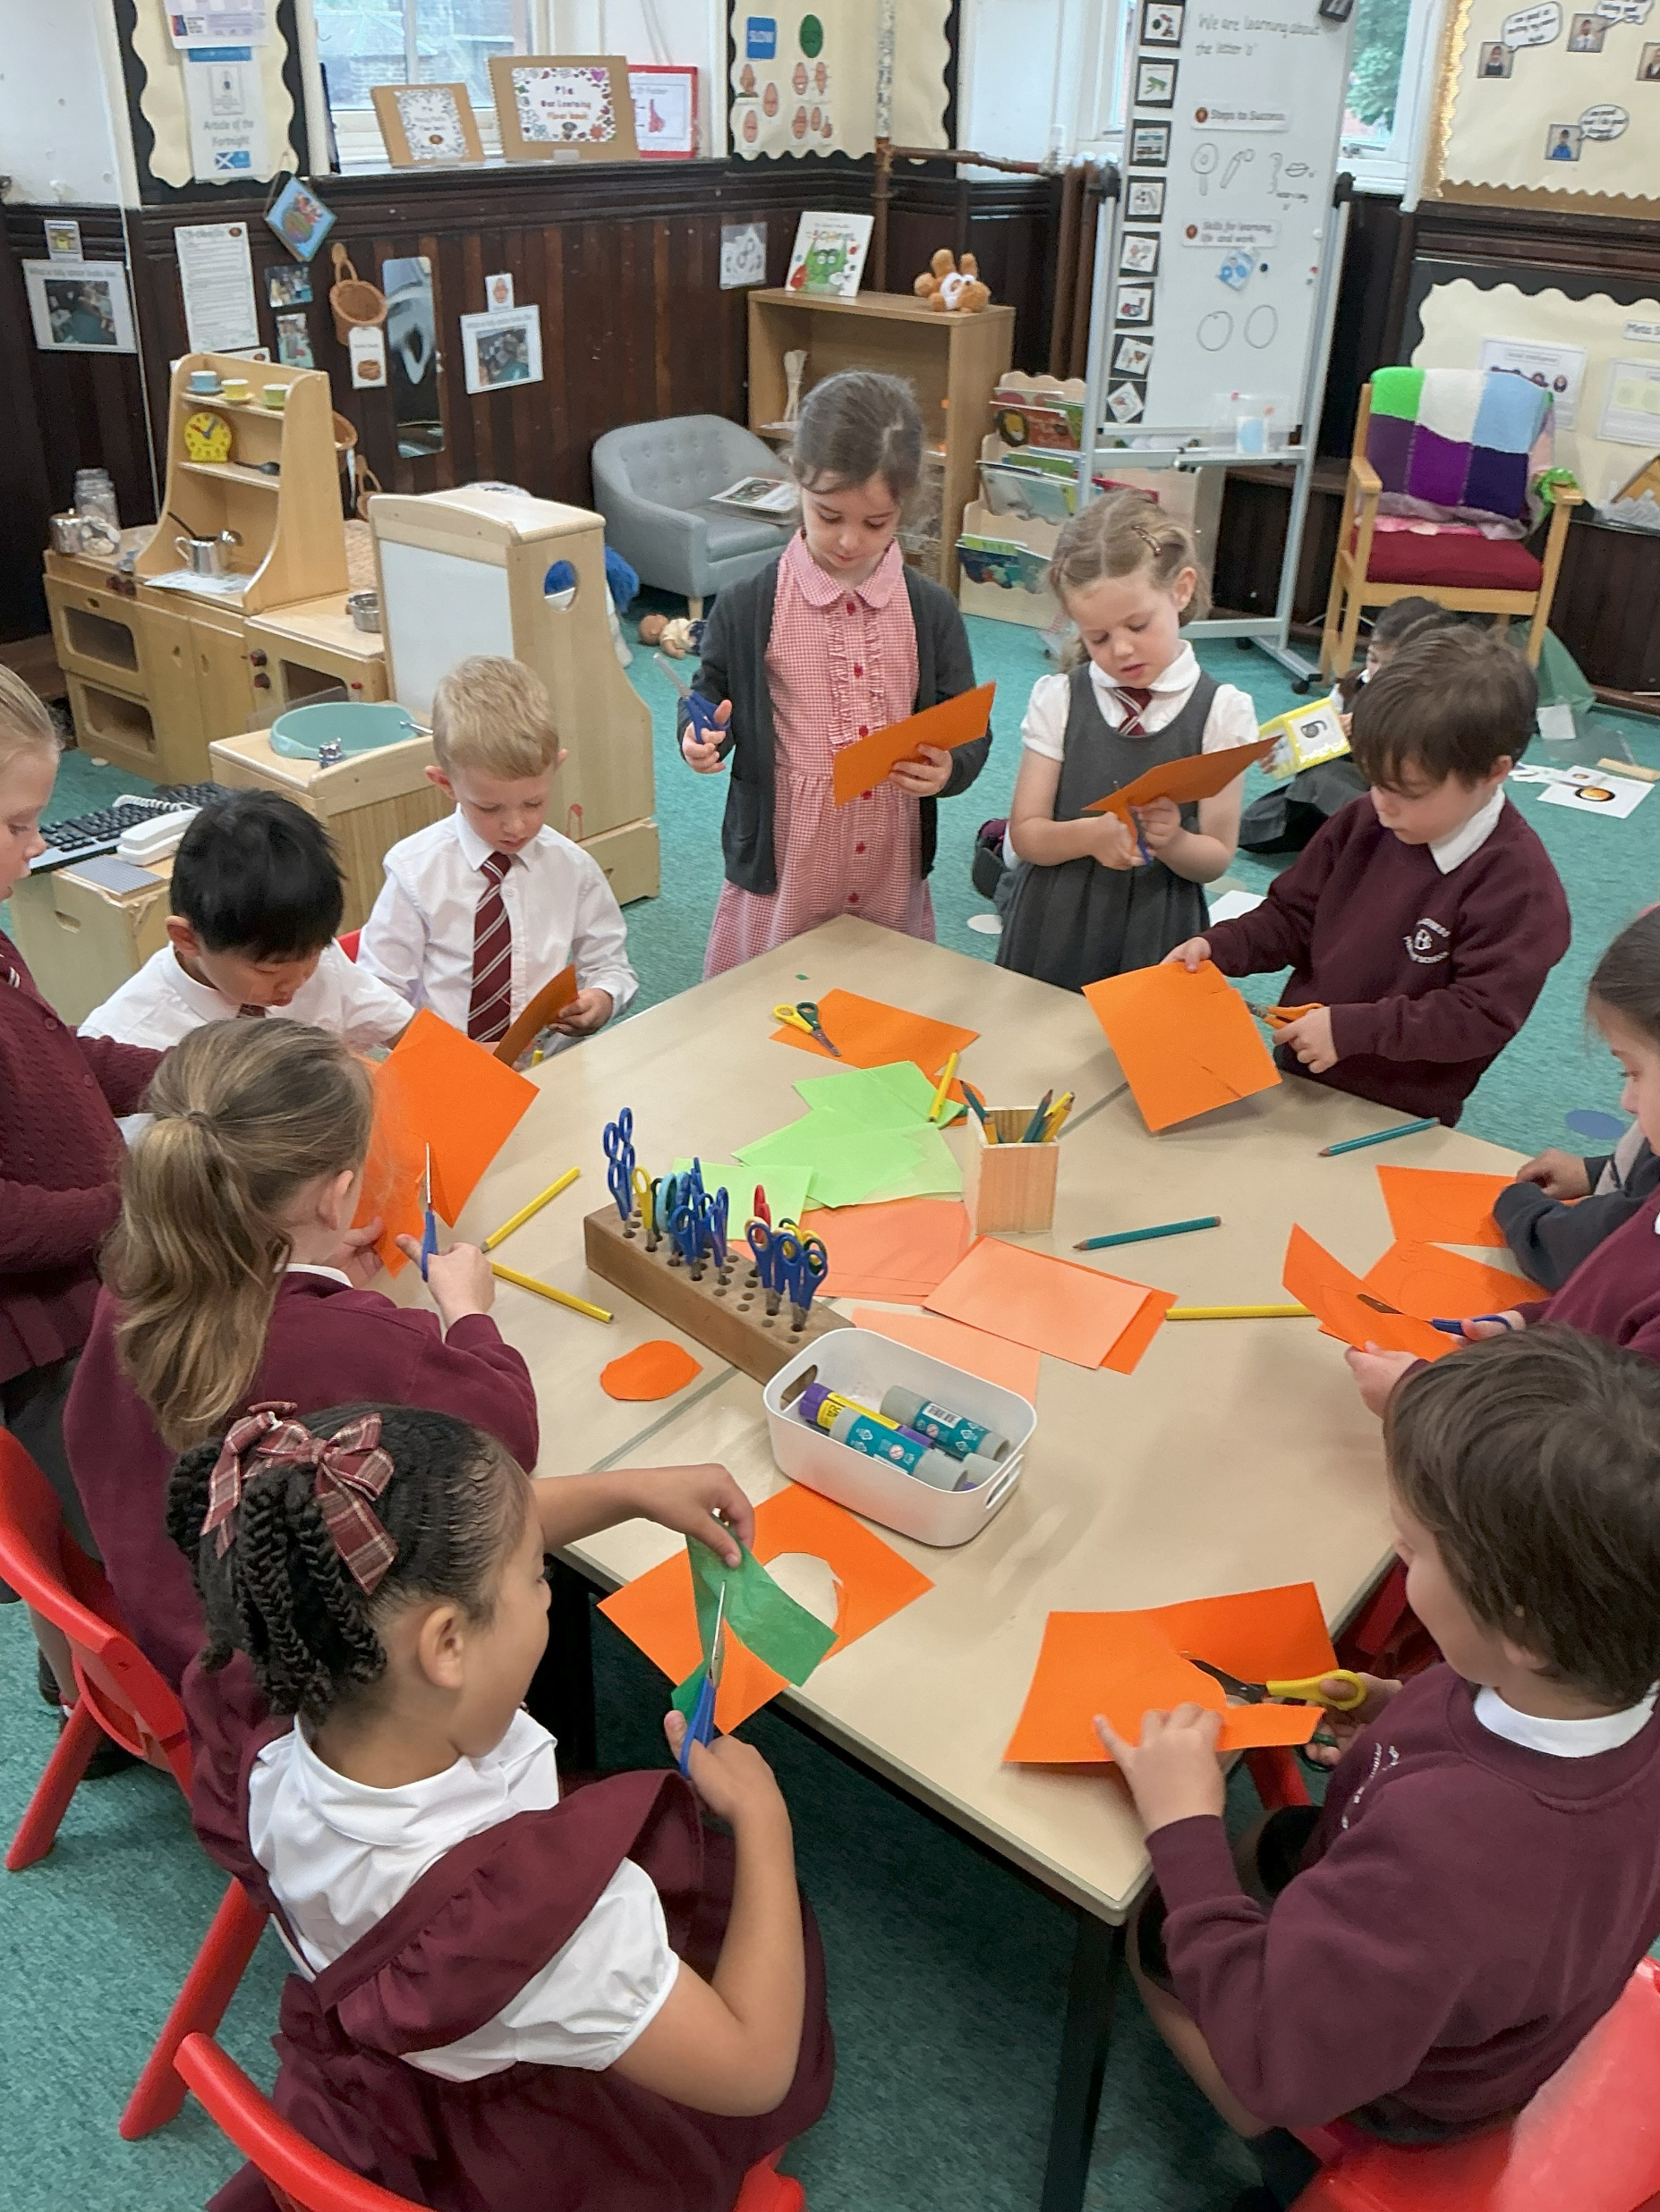
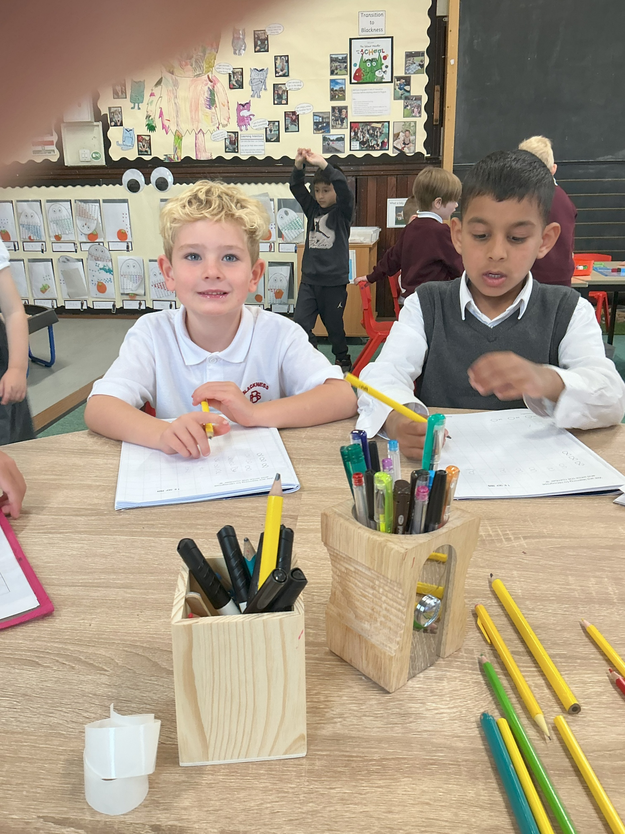
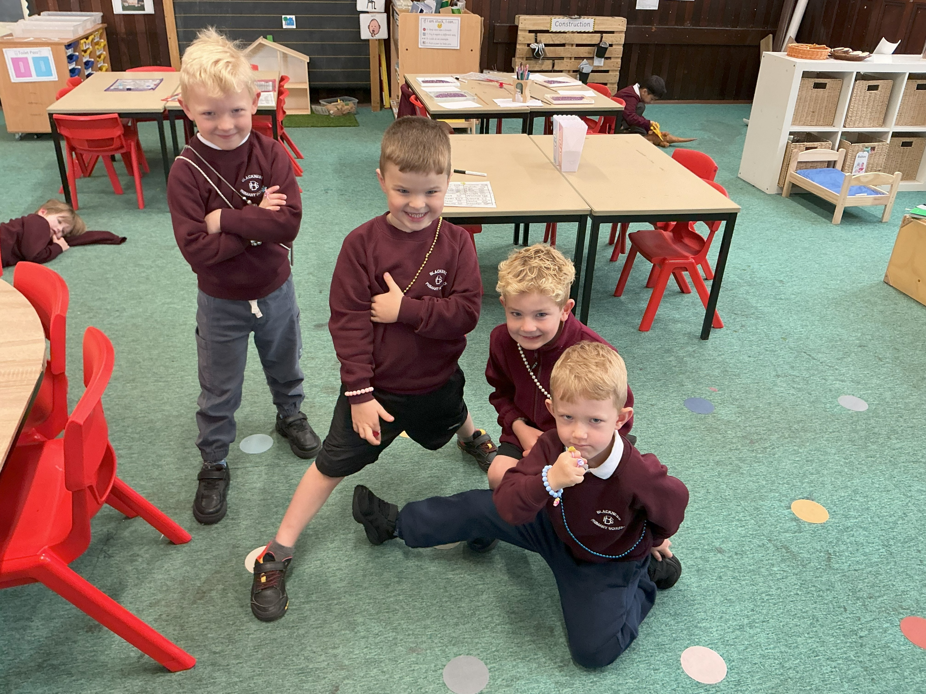
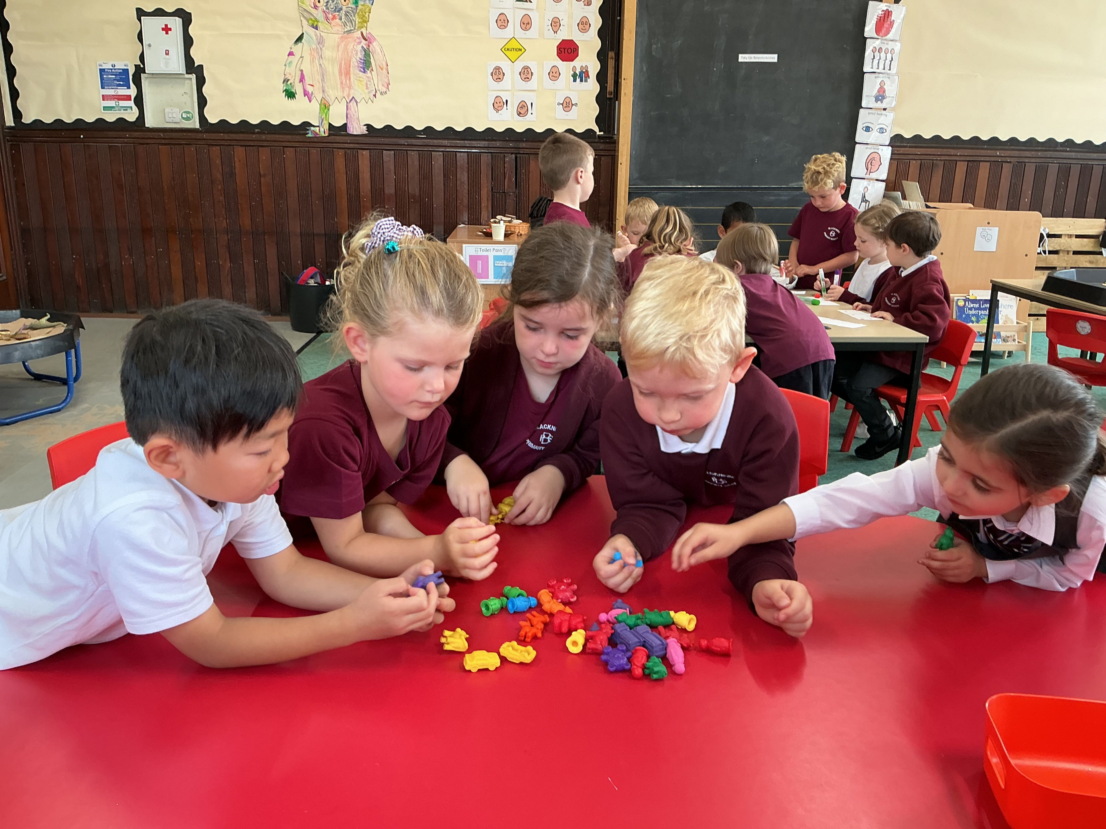
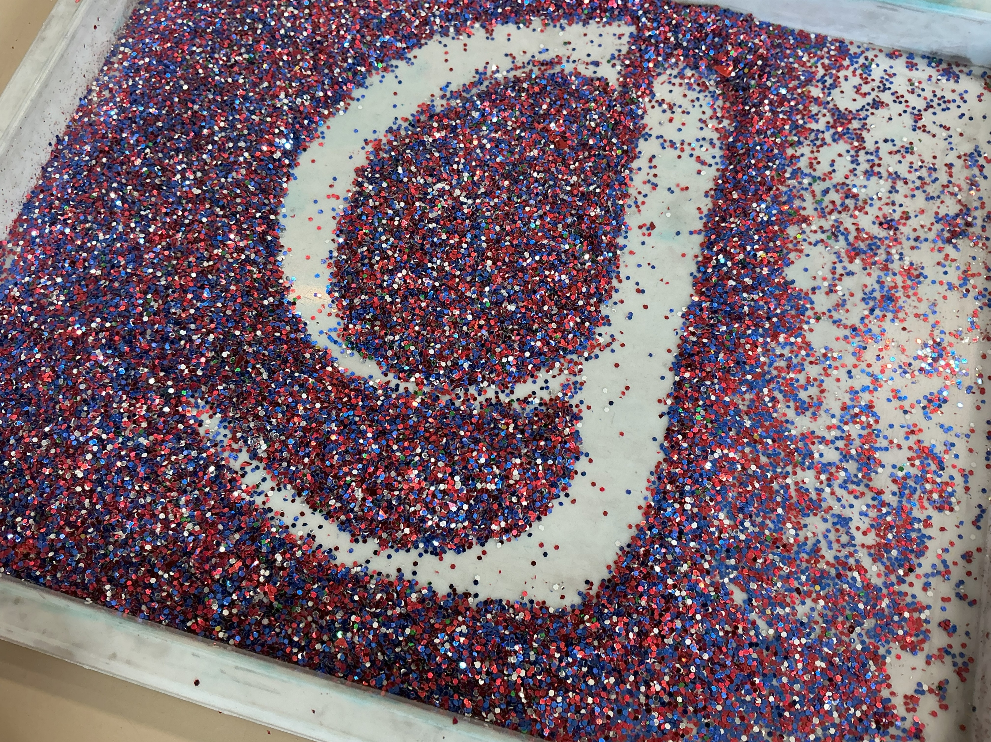
What a day in P1 looks like
Lots of play!
Teacher Table Tasks
Gold Star Tasks

Slide 6
What does play look like in P1?
Play is embedded into everyday
Soft Start
Guided play through gold star tasks
Free Play
Outdoor Play
Meta- Skills Focus
Observing Adults- Adding Support and Challenge

Slide 7
Continuous Provision
The continuous provision has been carefully curated to ensure children have opportunities to develop their skills, schemas and interests.
A schema is a repeated pattern of behaviour- transporting, trajectory, enclosing, rotation
Children use the provision throughout the day, in between gold star tasks and during planned play periods.
‘Play in progress’ triangles are used so that they can revisit play
Meta skill development is a big focus for play- there is a meta skill check in at the end

Slide 8
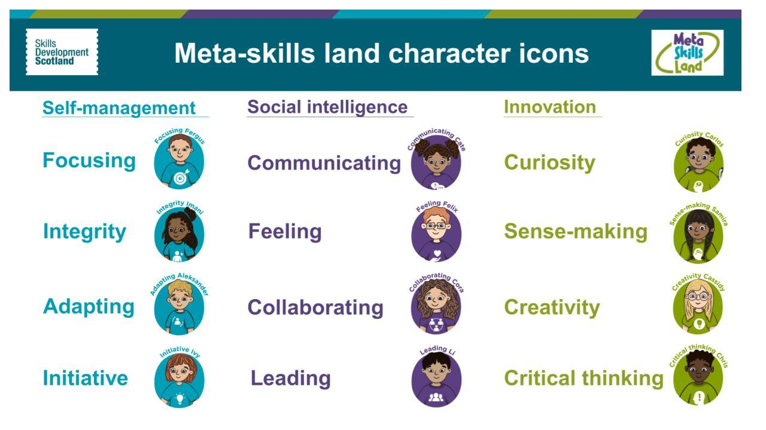

Slide 9

Outdoor Play
Importance of this- health, physical, mental and social development
Outside in all weathers!
Messy Maths Programme
Playpod- large loose part play
Future outdoor play opportunities- in the local community

Slide 10

How is my child’s development being supported?
Play is purposeful, planned interactions, planned skill focus
Teachers use a wait, watch and wonder approach to support and challenge
Play is documented- floor books children are part of creating the these
Individual observations- Next steps in play are identified and followed through, they are specific for every child
Planned Provocations- Literacy and Numeracy

Slide 11


Slide 12
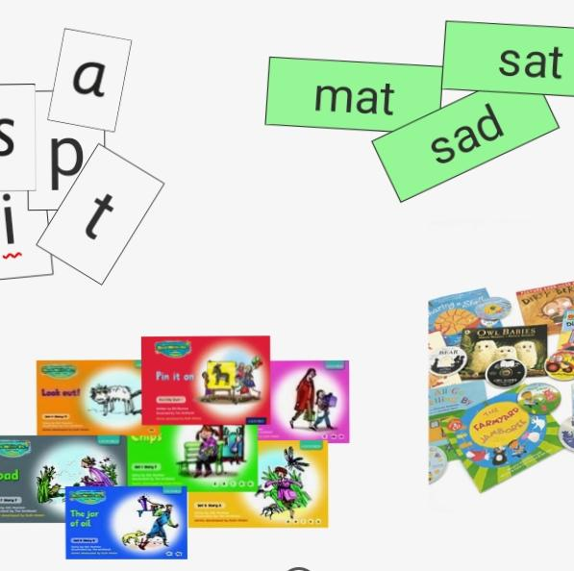
An Introduction to RWI

Slide 13
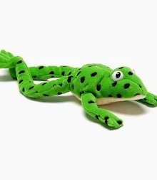
R.W.I Terms
Fred – Fred is a bossy frog who can only speak in sounds (segmented)
Segmenting- breaking words into the sounds within it
Special Friends – Sounds that work together eg sh ch th
Fred in your head – reading the word without sounding it out
Red words – words that don’t follow the pattern
Green words - words that we can sound out
Alien words – words made up of sounds that are nonsense words
Blending – pushing the sounds together to read words
Fred fingers – Spelling using fred

Slide 14

Sounds
Pronunciation is key!
When we are learning to read it’s important we deal with sounds and not letter names
Pronouncing as a pure sound- no ‘shwa’ on the end. E.g t not ti and g not gi

Slide 15
Learning to Blend
We learn to blend orally first
Then we read the words by breaking them into sounds
Fredding out loud – This is where we say the sounds out loud then slide them together to hear the word
Fredding in our head – This helps to develop fluency and reading at speed
Videos are available on Youtube to show you how to support your children when learning to read type in Ruth Miskin Parent video in the search bar

Slide 16
Writing Words
We break words into their sounds, practicing this orally lots of times before we write them down
Nonsense words are important to check children have developed the skill of blending and are not guessing at familiar words
Spelling at this stage is mainly phonetic unless it’s a red word we know.

Slide 17
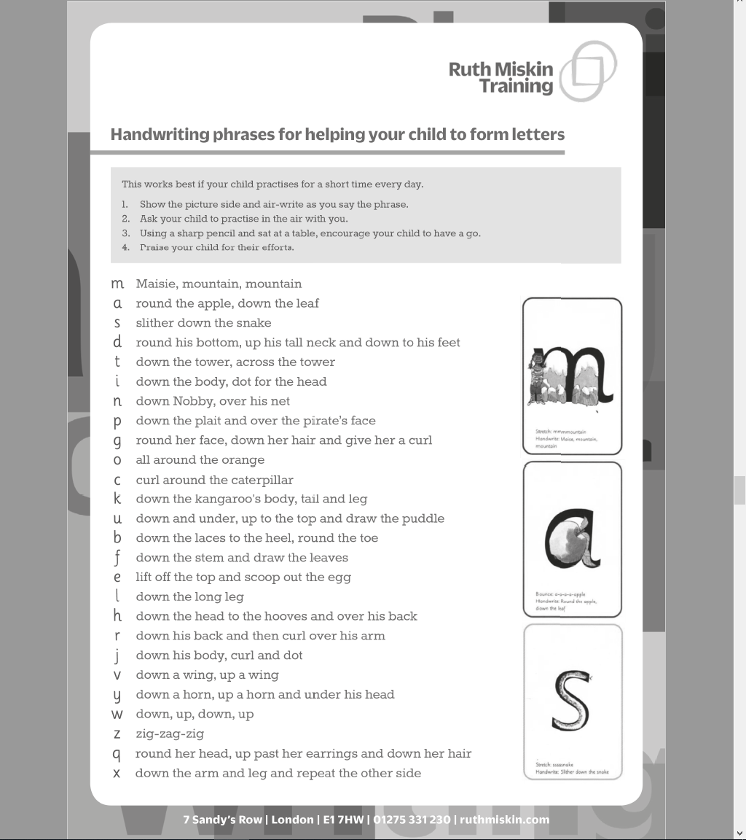
Fun Formation
Fine Motor Skills are developed across multiple areas in School
Lots of ideas without using a pencil!
Get creative … sand, water, mud, cars, paint …

Slide 18

Drawing Club
A play-based writing approach by Greg Botrill
It encourages discussion, mark making and mathematical concepts- it is the foundation of writing
We explore a story in depth across the week
We talk about character, setting and plot
Children are then encouraged to create their own take on the story through drawings
The children are encouraged to add as much detail as possible for fine motor skills development
A magic literacy and numeracy button are added- this encourages children to try out their new knowledge of sounds/ numeracy/maths concepts
Creativity is encouraged- have a look at some of your children’s amazing ideas!

Slide 19
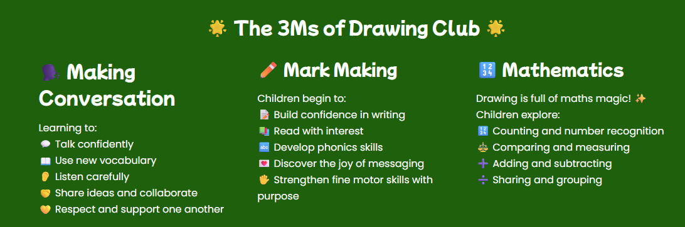

Slide 20
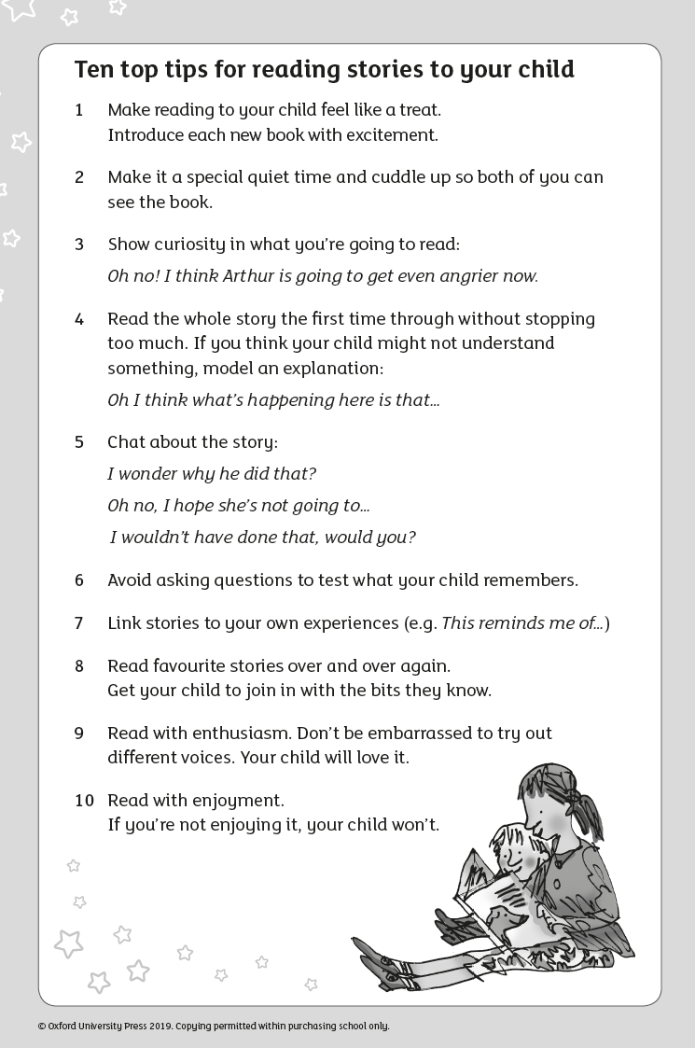
Story Telling
Develop a love of reading
If you share just 1 story a day at home that’s 365 stories they have been exposed to in a year
Parent video: 10 things to think about when you read to your child - YouTube
Over 2 years that’s 730 stories
Regular story times happen in class at least once per day

